Slide 1
LIO_CINEMA AND JOTSTAR MERGER IN OTT DOMAIN
Prepared by – Ria Agarwal

Slide 2
Problem Statement: Provide Insights for a Strategic Merger in the OTT Domain
Lio, a leading telecommunications provider in India, is planning a strategic merger with Jotstar, one of the country’s most prominent streaming platforms. This potential partnership aims to combine LioCinema’s expansive subscriber base and Jotstar’s diverse content library to revolutionize digital streaming in India.
As part of the merger preparation, the management team at Lio wants to analyze the performance and user behavior of both platforms—LioCinema and Jotstar—over the past one year (January to November 2024). The goal is to gain insights into individual platform performance, content consumption patterns, subscriber growth, Inactivity behavior, upgrade and downgrade trends. The insights derived from this study will help the management make informed decisions and optimize content strategies post-merger, with the ultimate goal of establishing Lio-Jotstar as the leading OTT platform in India.

Slide 3
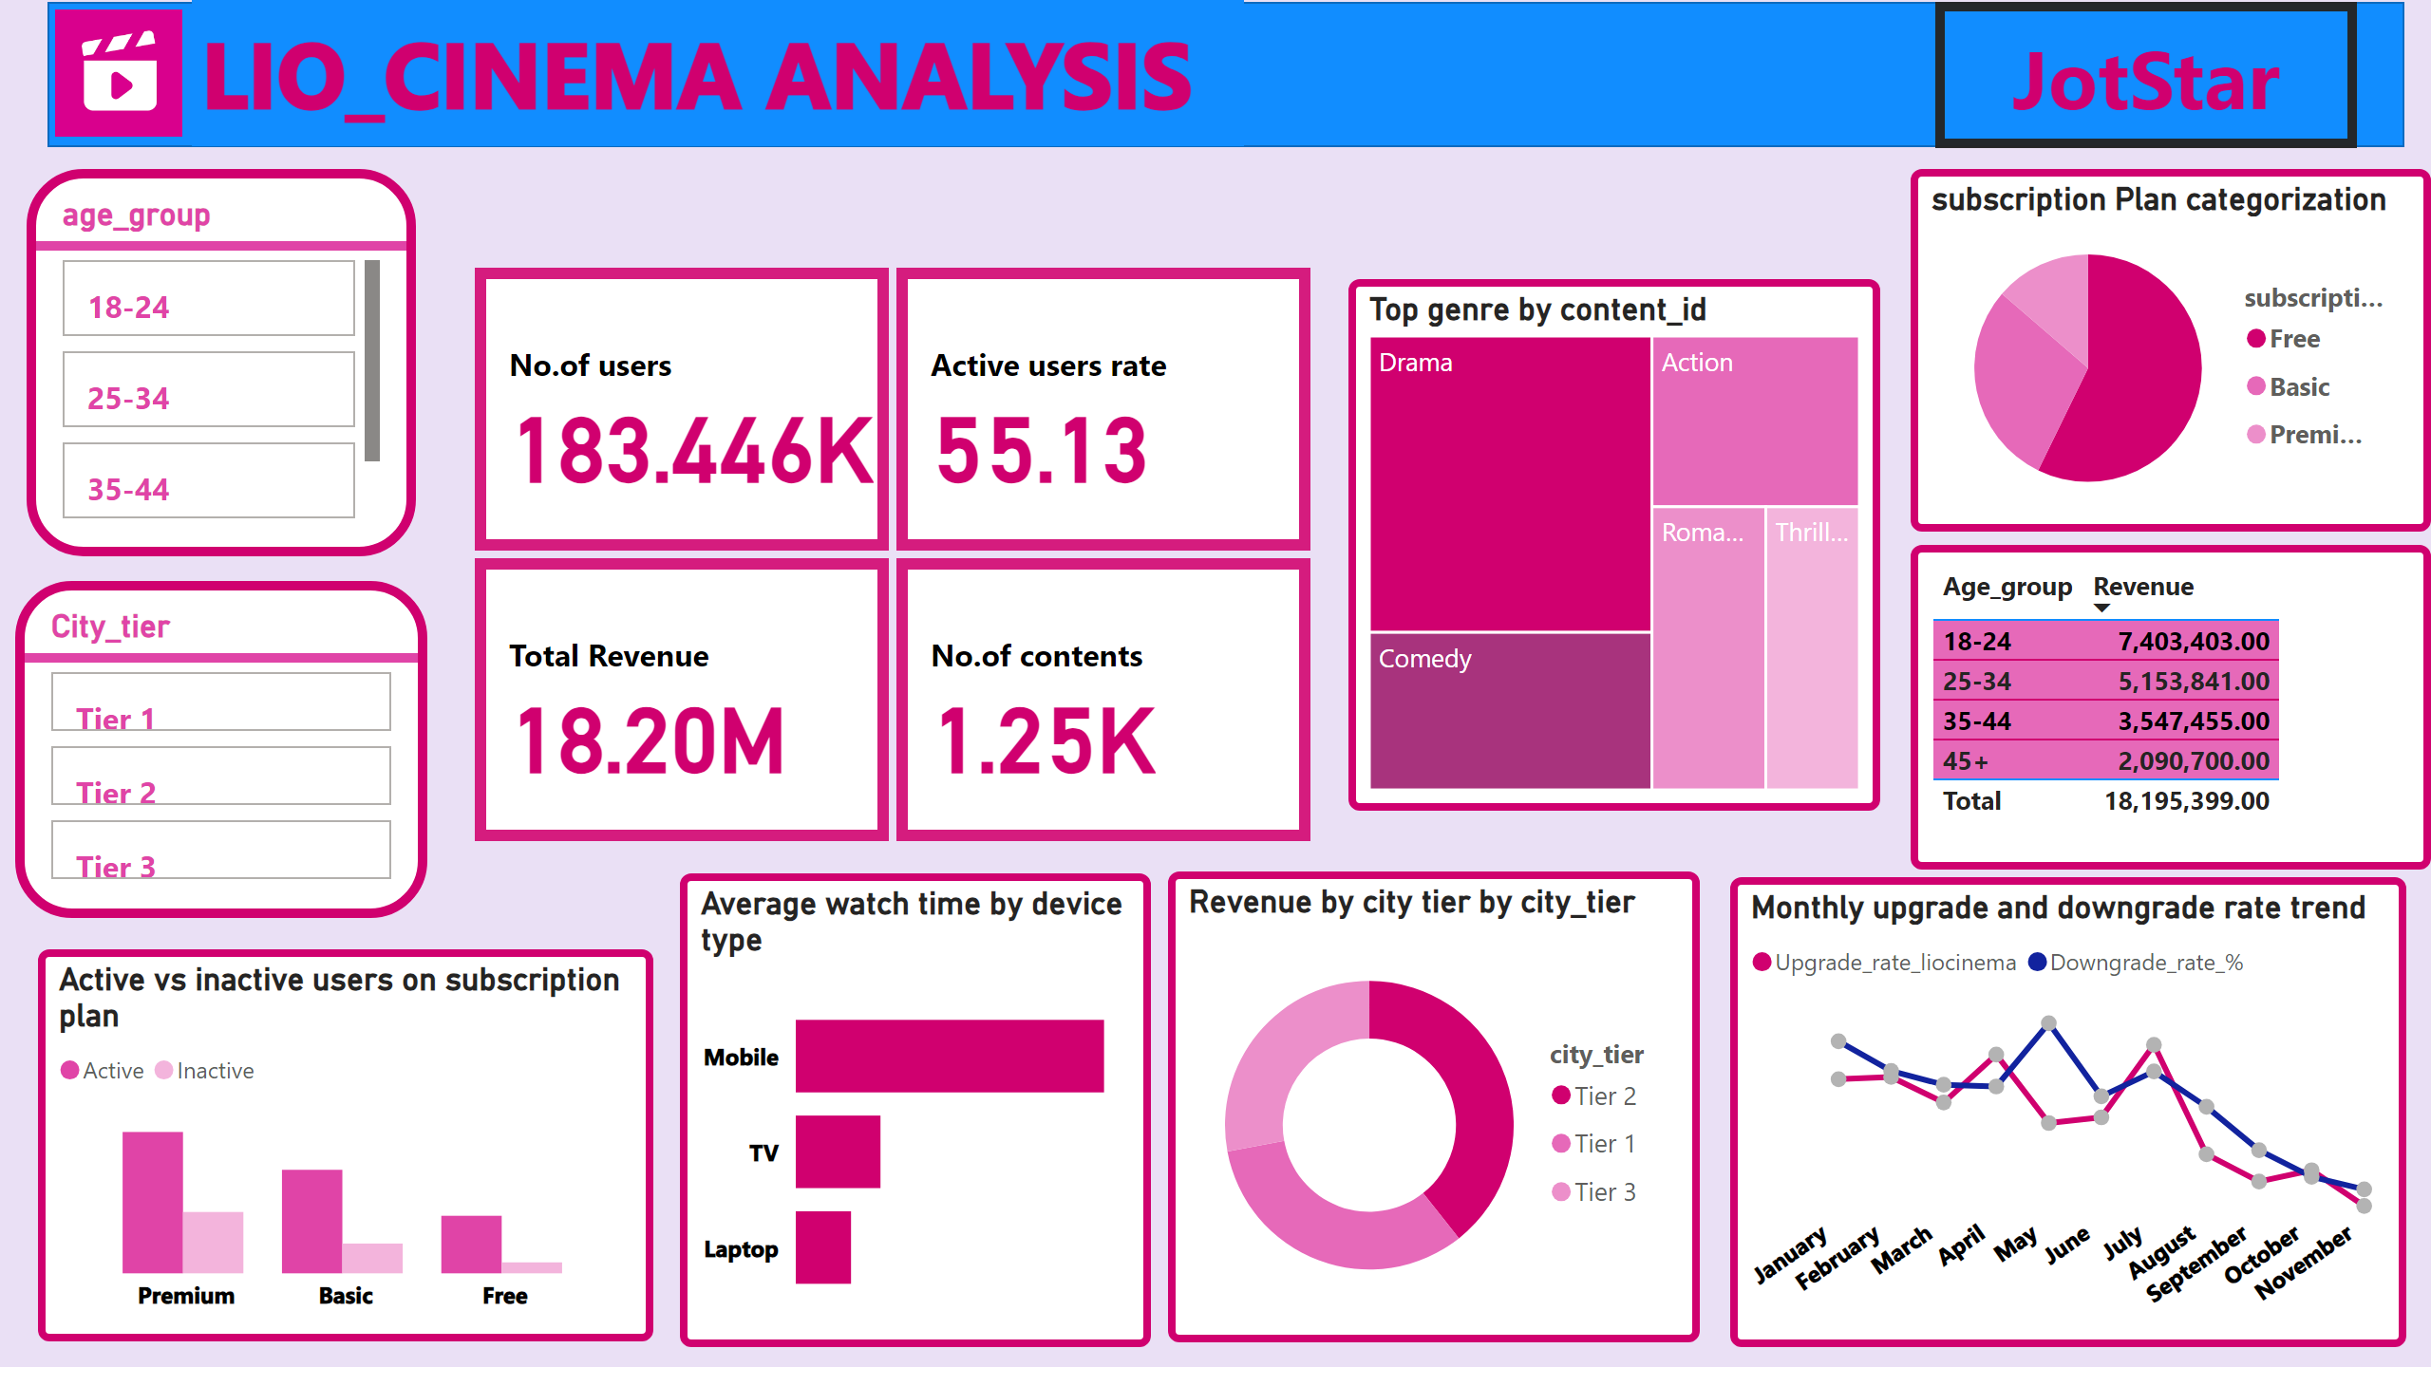

Slide 4
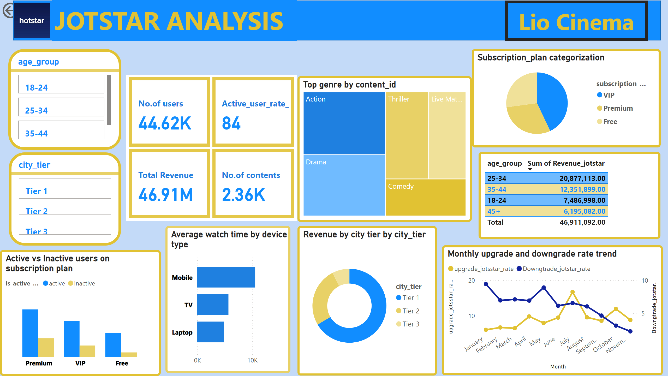

Slide 5
CONCLUSION:
In both the platforms, avg watch time by mobile is highest as compared to other device types.
In lio_cinema platform maximum revenue arises from tier 2 cities, users belongs to 18-24 age group,and mostly relies on free subscription plan. whereas in jotstar maximum revenue arises from tier 1 cities, belongs to 25-35 age group and they mostly relies on Premium subscription plan.
Both the platforms have maximum upgrade rate of users in the month of July.
In both the platforms, active user vs inactive user comparison with average watch time shows a significant difference in avg watch time which suggests that inactive users are leaving the platform might be due to not liking of contents ,so they need to diversify their contents in order to increase their retention rate.
In lio_cinema the no. of users and active rate is more as compared to jotstar but jotstar is generating higher revenue as compared to lio_cinema because majority of users in jotstar prefer VIP plan unlike lio_cinema free plan.

Slide 6
Recommendations:
After the merger, the ott platform should offer lucrative offers to the users in the month of July as the upgradation rate is more in this month.
As the majority of users are from tier 1 and tier 2 cities so they should mostly focus on these cities after their merger and should provide an optimum price plan so that the users from both the platform can access their plans.
The merged platform should bring some new contents so as to attract and retain the users.
This merger would be positive for both the companies as liocinema has more number of users and jotstar has more number of contents than liocinema as compared to jotstar and this merger will eventually

Slide 7
Thank You

